Slide 1
0-1 Japanese Language
Introductory
Click to begin

Slide 2





Portfolio
http://kyoshiexile.com
Ae
Ps
Dw
An
EN
"Art is a form of expression, valued in its concepts to convey meanings through visuals."​
Justin firmly believes that art is a communication platform to drive across what we feel and think, not just looking at its outcome alone.
Setting visions on Animation Design, Justin hopes to communicate inspirationally and conceptually through his work on the importance of values in our lives. Being involved in marketing operations also gave him wider range of assets in his arsenal as he sees opportunities to broaden his influence.
As per his individual projects, Justin is proven to work independently but at the same time express his keen willingness to work in a team as well. He is open to constructive criticism constituting to an effective workflow. Overall, Justin knows his limitations as well as his strengths and will constantly build up his skills to catch up with the ever-changing trends.
CH
Id
Ai
Mu
Lr
JP
CERTIFICATION
ACHIEVEMENTS
PRODUCTS
1 YEAR
2 GAMES
1 APP

Slide 3
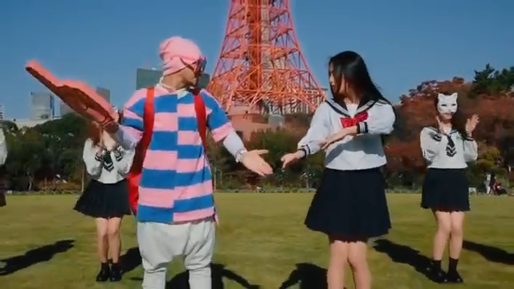
Video
Kohi
Soseji
Hoteru

Slide 4
Lesson Objectives
Learn the 5 Japanese vowels and understand the Japanese sentence structure

Slide 5
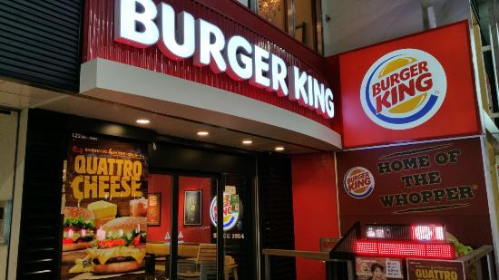


Case Study
SAMPLE MENU
XXXXXX 640 ¥ | 530 ¥
XXXXXX 780 ¥ | 590 ¥
XXXXXX 930 ¥ | 720 ¥
Image taken from TripAdvisor
You are ordering from Burger King in Osaka, the staff has zero knowledge in English and you wanted to order an ala-carte burger.
You pointed at the desired picture which contained 2 prices and you pointed at the one with the lower price assuming it to be ala carte but she doesn’t understand you, and kept on thinking you wanted a set meal. After much struggle, you felt the people behind growing impatient, as all the staff were busy to help too. What would you do?

Slide 6





Vowels
Show all
A
I
U
E
O

Slide 7
Vowels
Show all
A
I
U
E
O

Slide 8
Vowels Practice
Do you remember the images for each vowels?
Try pronouncing
A
I
U
E
O
Reveal Answers

Slide 9
Characters
K
K
K
K
K
A
I
U
E
O
Play

Slide 10
Characters
K,G,S,Z
H,B,P,M
N,R,T,D,W,Y,J
K,G,S,Z
H,B,P,M
N,R,T,D,J
K,G,S,Z
H,B,P,M
N,R,T,D,Y,J
K,G,S,Z
H,B,P,M
N,R,T,D,J
K,G,S,Z
H,B,P,M
N,R,T,D,W,Y,J
A
I
U
E
O

Slide 11
Words
Try pronouncing
Wa
Ta
Shi

Slide 12
Words
Watch closely
Wa
Ta
Shi
Play
Watashi wa kiyoshi desu

Slide 13
Universal
Sentence
Connecting
words
Particle
Object
Topic Marker
OR Subject
‘Be Verbs’
(is/are/am)
A wa B desu.
A is B.
Play
Watashi wa Kyoshi desu.
I am Kyoshi.
No ‘a/the’
No singular/plural

Slide 14



Practice
A wa B desu.
A is B.
A
B
I
You
He
She
They
We
It/This
Watashi
Anata
Kare
Kanojo
Karera
Watashitachi
Kore
Gakusei
(Ga ku se I)
Student
Isha
(I sha)
Doctor
Keisatsu kan
(Ke i sa tsu kan)
Policemen

Slide 15
Practice
Now it is your turn to do a self introduction in Japanese

Slide 16
Roleplay
He is a student.
She is a teacher.
We are doctors.
1
2
3

Slide 17
Roleplay Part 2
Now, let’s break them up!
She is a student.
He is a teacher.
We are doctors.
1
2
3

Slide 18
Quiz

Slide 19



Reconstruct
Form sentences and strike conversations within your groups
A
B
I
You
He
She
They
We
It/This
Watashi
Anata
Kare
Kanojo
Karera
Watashitachi
Kore
Gakusei
Student
Isha
Doctor
Keisatsu kan
Policemen
Tori
Bird
Neko
Cat
Bengoshi
Lawyer

Slide 20

Poll
https://live.voxvote.com
Code: 308666

Slide 21

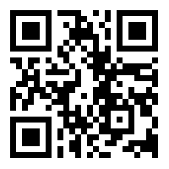

By the way

Slide 22
Thank You

